Slide 1
Integrative Therapeutics for Gastrointestinal Dysfunctions Part 2:Gastrointestinal Issues- Inflammatory Cycles
PJ Broadfoot DVM
Leon, Mexico 2019

Slide 2
Repair and Restoration of GIT
Consider in ANY integrative health program
The importance of the alimentary system cannot be overstressed, yet it is often overlooked in our “pieces and parts” medical system
Chronic inflammatory cycles are common and contribute to global inflammation
Antibiotic overuse has created a firestorm within
We will focus on renewing the health of the gastrointestinal system, via supplements, nutritionals, and Homotoxicology.

Slide 3
FMT and the “Falling Horse” 1981

Slide 4
Enlisting Commensals
Peripheral education of the immune system by colonic commensal microbiota
Intestine key to induction of peripheral tolerance
iTregs induced by recognition of commensal antigens
Novel therapeutic strategies for autoimmune and inflammatory diseases by targeting intestinal microflora and intestinal milieu
If the thymus “banks” self antigens, the intestines may serve as a repository of non-self antigens

Slide 5
Notes:
Gut matters: Microbe-host interactions in allergic diseases
Gabriele H€ormannsperger, PhD,* Thomas Clavel, PhD,* and Dirk Haller, PhD Freising-Weihenstephan, Germany

Slide 6
Mucosal Immunology
Mucosal immune system discriminates between pathogenic and commensal bacteria through pattern recognition receptors, which detect bacterial antigens and activate signaling cascades that regulate immune reactions (cytokines)
Commensal bacteria (probiotics) create a hostile environment for pathogenic bacteria by:
production of inhibitory compounds
competing for adhesion sites,
modulating immune response

Slide 7
The “leaky gut syndrome”
When villi of the intestinal tract have been damaged badly enough – and for a long enough time – to result in significant malnutrition, both from the lack of absorption into the bloodstream and from the leakage of substances from the blood into the bowel (e.g. serum proteins and serotonin)
Common Food Triggers that cause villous atrophy of small intestine: corn, soy, wheat gluten, & dairy (casein), & some legumes and nightshades.

Slide 9
Leaky gut syndrome- Four Stages
1) Hypersensitivity (allergy) - most common
Immediate reactions- e.g. classic dermatitis and otitis associated with food allergy
Delayed reactions- arthritis and other conditions not usually associated with food allergy
2) Malnutrition with elements of maldigestion/ malabsorption, → poor hair coat, actual weight loss and vitamin/mineral deficiencies

Slide 10
Leaky gut syndrome- Four Stages
3) Hepatic stress- manifesting in elevated liver enzymes of two patterns.
If the liver is being stressed by toxins both ALT and ALP will be elevated
If only ALP is elevated, IBD may be stimulating excessive cortisol production by the adrenal glands
4) Bacterial dysbiosis (intestinal bacterial overgrowth)

Slide 11
Leaky Gut Syndrome
Chronic low-grade endotoxemia →autoimmunity, increases the liver detoxification burden →chronic hepatitis
Autoimmune, inflammatory, and neoplastic diseases assoc. with elevated levels of zonulin & increased intestinal permeability→ celiac disease, type 1 diabetes, and juvenile nonalcoholic fatty liver disease, multiple sclerosis, rheumatoid arthritis, asthma, inflammatory bowel disease and even, cancer!

Slide 12
DIAGNOSTICS for Gut Inflammation
C-Reactive Protein (CRP) & Occludin
Zonulin, the most practical approach to testing the GIT. Zonulin is a protein, synthesized in intestinal and liver cells
Zonulin is a clinically useful marker of intestinal permeability , as zonulin induces breakdown of the tight junctions between intestinal epithelial cells

Slide 13
Zonulin Function
Allows for getting nutrients into the blood stream if the intestinal villi – are compromised significantly.
However, allows more potentially harmful substances to enter the bloodstream, including microorganisms, chemical compounds, and food proteins
Partially undigested foods crossing the compromised gut barrier →“secondary food allergies” – e.g. to eggs, tree nuts/peanuts, shellfish, tropical fruits, tomatoes, etc.-

Slide 14
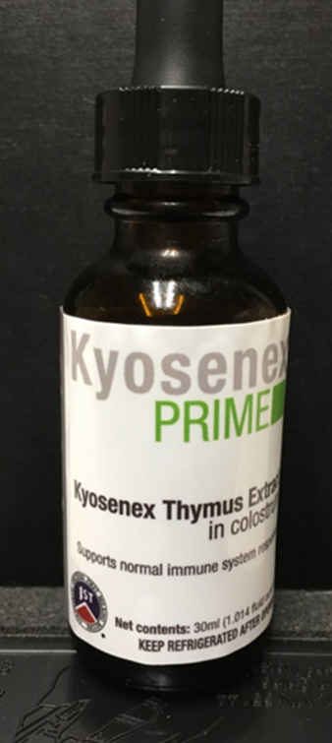
Zonulin and a Possible Therapeutic Study
Circulating zonulin is a clinically useful marker
The ONLY regulator of intestinal permeability known to be reversible, which makes it valuable in monitoring therapeutics
Interest in studying Thymus and Colostrum to test the reversibility by a supplement

Slide 15
Antibiotics and Dysbiosis
Antibiotic long term effects on the microflora
One study showed over 600 days of dysbiosis in cats with a single round of Clindamycin
Antibiotic resistance is a looming spectre, as we are running out of “ammunition” in the war on microbes
Time to study new diagnostics and therapeutics, as they are the wave of future therapy!

Slide 16
Restoration of the GIT Mucosal Barrier
Dietary changes
Treatment of dysbiosis via Digestive support
Anti-inflammatory therapies
These may include supplements such as quercetin, vitamin C, curcumin, gamma-linoleic acid, omega-3 fatty acids (EPA, DHA), and aloe vera.
Other nutrients such as zinc, beta-carotene, pantothenic acid, and L-glutamine may provide some support for rejuvenation of the GI mucosa

Slide 17
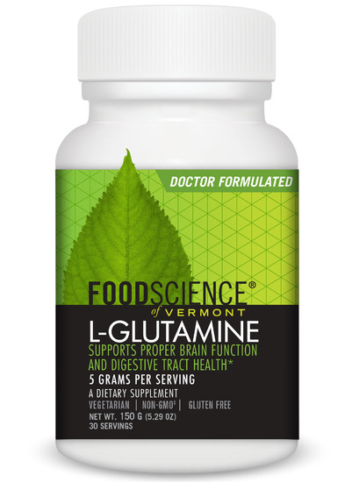
Glutamine
Well studied supplement for gut health
L-Glutamine plays a critical role in healthy digestion & brain function
Protects against mucosal breakdown in the gut
Very high doses may be required,
Suggested to increase slowly

Slide 18
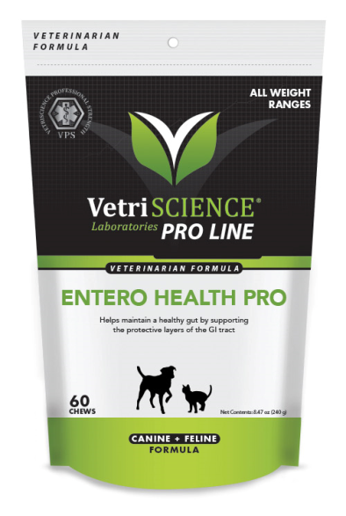
Entero Health Pro
Entero-Chronic® proprietary blend:
(α-Glucans, mannan oligosaccharides (MOS), β-Glucans, mucopolysaccharides).1500 mg
L-Glutamine.200 mg
Slippery Elm (Ulmus rubra) Bark .100 mg
L-Arginine.40 mg
PepZin GI® Zinc Carnosine (ZnC chelate complex) .40 mg

Slide 19
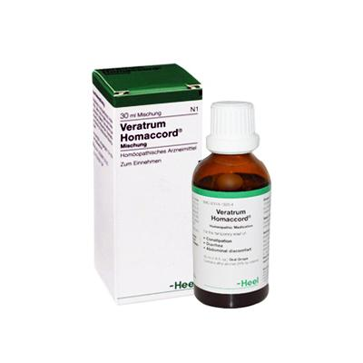
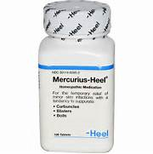
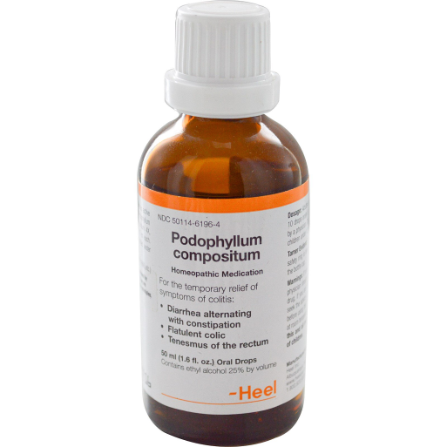
Nanopharmacology-Bioregulatory
Crohn's disease (CD) suspect bacterial antigens, e.g. Mycobacterium avium subsp. paratuberculosis (Map)- a zoonotic pathogen? Similarity of lesions in cattle w/ Johne’s

Slide 20
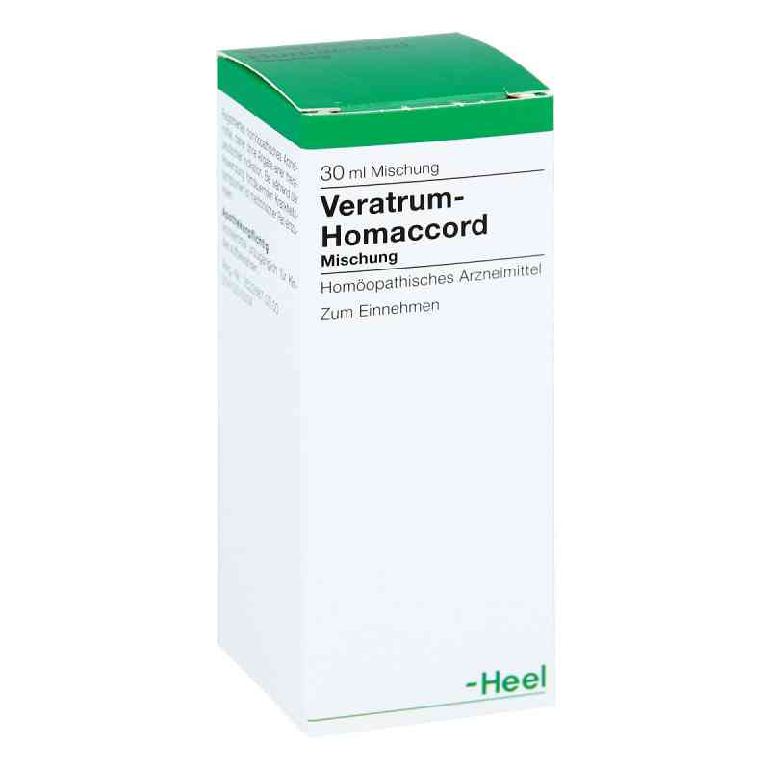
Complex homeopathics for Crohn’s, et.al
Veratrum-Homaccord w/ a potency chord for enteritis:
abdomen painful to palpation; nocturnal abdominal pain with sleeplessness; “cramps and sharp colic pain in the abdomen, watery diarrhea (rice water stools); acrid nocturnal diarrhea; bloody stool; anal burning
melancholy, dejection, sadness, discouragement, and despair; timidity
We often give with Hepar Comp as a mixed injection

Slide 21
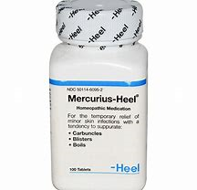
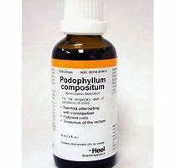
Complex homeopathics for Crohn’s, et.al
Mercurius-Heel- during the silent phase of the enteritis when inflammation is at its highest point.
Podophyllum compositum- wonderful for IBS,
Indicated when the catarrhal colitis is at its peak, accompanied by painless diarrhea, hemorrhoids or rectal tenesmus

Slide 22
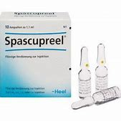
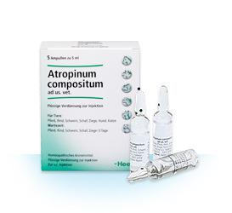
Homotox for Spasmodic Pain
Spascupreel and Atropinum compositum.
Several ingredients modulate various central and peripheral targets of the brain-gut axis

Slide 23
Spascupreel
Targets multiple receptors
muscarinic acetylcholine receptors (affecting smooth muscle contraction and motility)
gamma-aminobutyric acid-A (GABA type A) receptors (associated with CNS processing of mood disorders, including anxiety)
dopaminergic receptors type 2 (affecting central control of the pain response)
Inhibits the enzyme monoamine oxidase B (MOA-B), helps regulate levels of dopamine and other neurotransmitters

Slide 24
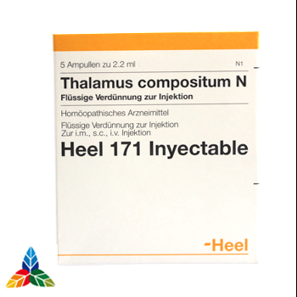
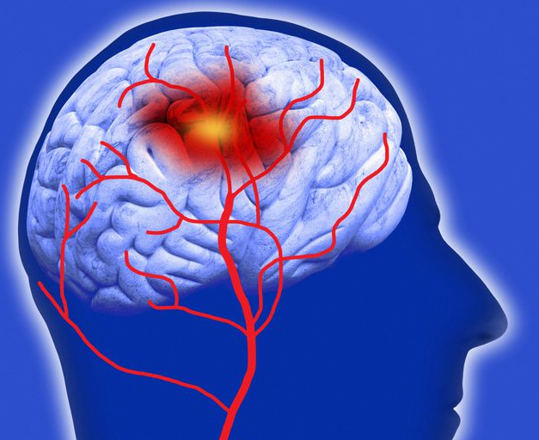
More Homotox
Thalamus compositum (for central pain syndromes)
Tonsilla compositum (for disturbances of the HPA), also used to influence the gut-brain axis

Slide 25
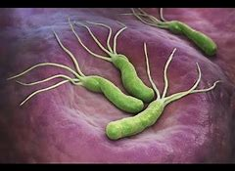
Homotox: Altering the microbiome
Interventional trial on eradicating H pylori: Gastricumeel, Nux vomica Homaccord, Lymphomyosot, Coenzyme compositum/ Ubichinon compositum
Mucosa compositum for mucosal repair

Slide 26
What About Diet???

Slide 27
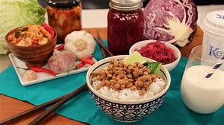
DIET: Unpasteurized, Fermented Foods
Supply beneficial gut bacteria
Lassi (an Indian yoghurt drink), kefir, pickled fermentations of cabbage, turnips, eggplant, cucumbers, onions, squash, and carrots, and natto (fermented soy)

Slide 28
DIET: Unpasteurized, Fermented Foods
Some fermenters chelate heavy metals and pesticides
Source of vitamin K2- a vital co-nutrient to both vitamin D and calcium
Most probiotic supplements have a fraction of the beneficial bacteria found in such homemade fermented foods.

Slide 29
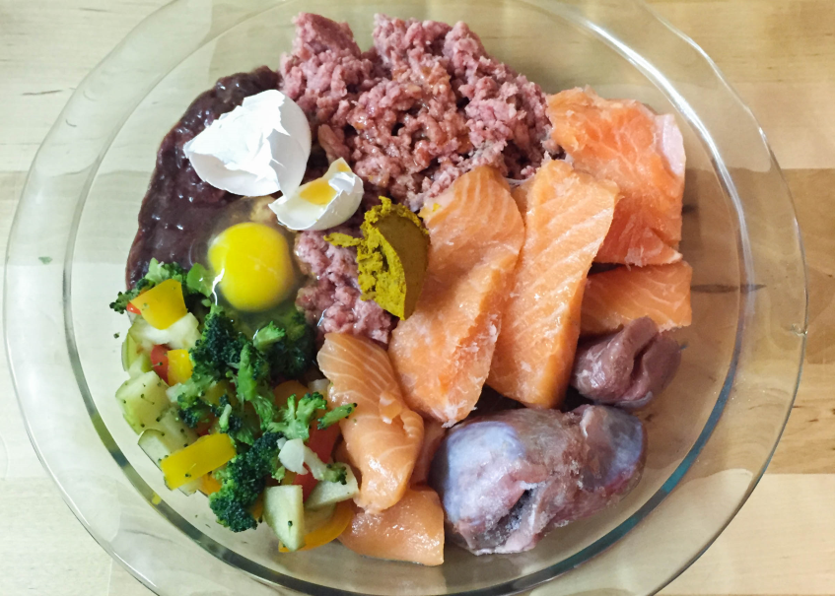
Raw Feeding- Study
Comparison of diets in dogs
Modification of microbiome attained with considerable variation of dietary regimes
Highly digestible feed, combining fresh meat with readily fermentable substrates, promotes a more balanced growth of bacterial communities and a positive change in healthy gut functions

Slide 30
Prebiotics- Non-Digestible
Selectively alter the growth or activity of intestinal microbiota
Inulin, fructo-oligosaccharides, galacto-oligosaccharides, soya- oligosaccharides, xylo-oligosaccharides, and pyrodextrins
Resistant to host digestion in the small intestine
Fermented in the colon
Might help to stabilize intestinal barrier
Enhance absorption of minerals, e.g. calcium, magnesium, zinc, and iron

Slide 31
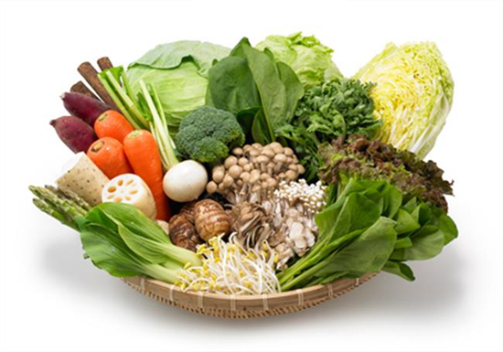
Prebiotics Improve Microbiome
Increase in Bifidobacteria and Lactobacilli species w/ decrease in Bacteroides, Clostridials, and enterobacteria
P-inulin increases bifidobacteria in the colon →alleviation of various aspects of the metabolic syndrome, e.g., obesity and diabetes mellitus

Slide 32
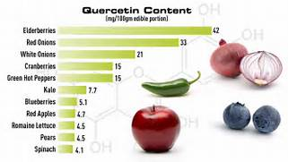
Quercetin
A plant polyphenol
Found in many fruits
Increases production of short chain fatty acids (SCFA) →improving the intestinal gut barrier and reducing hepatic inflammasones →modulation of diet-induced dysbiosis in mice with non-alcoholic fatty liver disease (NAFLD).
Reduced Helicobacter in diets containing high levels of fructose, a known gut barrier disruptor

Slide 33
Enteric pathogens
Can alter structure and function of tight junctions
Secretion of proteases cleave tight junction proteins or alter the cytoskeleton
Increase inflammatory cytokines such as TNFα and IFNγ, induced during infection and in IBD →intestinal permeability

Slide 34
Probiotics and Commensals
Can reverse inflammatory dysfunctions in intestinal epithelial cells,
improve barrier functions
inhibit pathogen adherence
Probiotics produce bacteriocins, increase IgA production, enhance nutrient absorption, and downregulate pro-inflammatory cytokine secretion

Slide 35
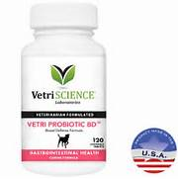
Vetri Probiotic BD
N-Acetyl Glucosamine (Shrimp and Crab)
FOS (fructooligosaccharides)
L-Glutamine
Arabinogalactan Powder
Alfalfa
Ginger
Pepsin Lipase Amylase Bromelain Papain
Probiotic blend:Lactobacillus Casei, Bifidobacterium Thermophilum, Enterococcus Faecium, Saccharomyces Boulardii

Slide 36
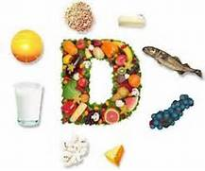
Vitamin D
Plays a role in the intestinal barrier
Deficiency → signs of IBD, correlated with the severity of disease
Vitamin D deficiency might compromise the mucosal barrier→ increased susceptibility to mucosal damage and an increased risk of IBD

Slide 37
Gc- Vitamin D Binding Protein
Important precursor to GcMAF is “Gc”, a large protein with three domains, the first of which binds vitamin D
When injury, inflammation, or any immune challenges occur, enzymes produced by B and T lymphocytes will convert Gc into GcMAF, one of THE most powerful known activators of the entire immune system

Slide 38
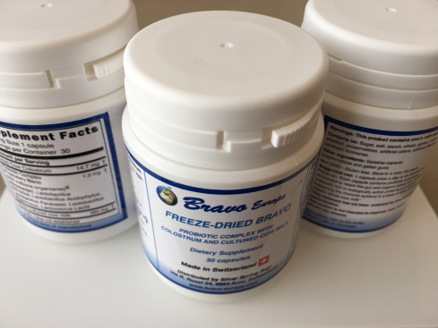
“ A Super Probiotic”
Macrophages function in both innate (non-specific) and adaptive (specific) immune defense mechanisms
Signal-directed by “Gc protein-derived Macrophage Activating Factor.” (GcMAF)
Bravo yogurt -early reports are quite favorable
GcMAF is concentrated in colostrum

Slide 39
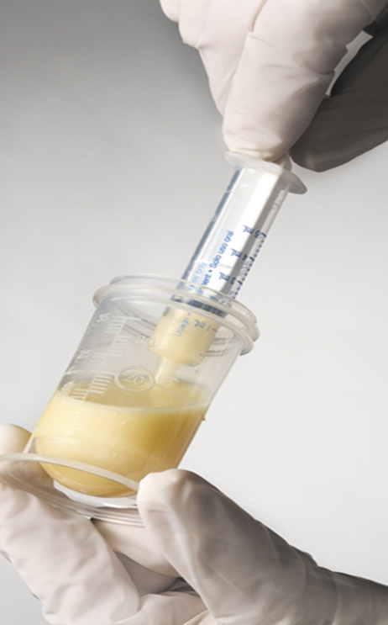
Colostrum- Lots of Research!
Antibacterial effect
Modulates immune response
Can neutralize lipopolysaccharides (LPS)- endotoxins from Gram-negative bacterial pathogens particularly after antibiotic therapy
LPS in blood is low in healthy individuals.

Slide 40
Colostrum
Can inhibit enterogenic endotoxemia:
Reduces influx of LPS from the gut in patients at risk for Gram-negative septic shock)
Reduces IL-6 and CRP (C-reactive protein)
Patients with chronic diarrhea with severe secondary immunodeficiencies were improved.
Good response in infants with hemorrhagic diarrhea caused by enterohemorrhagic E. coli, and reduced likelihood of the disease progressing to a hemolytic uremic syndrome

Slide 41
Colostrum
Tested in three Phase 1 and 5 clinical studies (Germany)
The LPS-lowering effects probably due to the numerous active components which originate in the innate humoral and adaptive immune system of their biologic source
Tolerability of this supplement is very good.
Colostrum is also remarkably high in zinc, which is critical to the function of the thymus gland
Notes:
Two trials in secondary immunodeficiencies, one in surgical patients with gastrointestinal disorders, one in patients undergoing open heart surgery and one in pediatric patients with EHEC infections

Slide 42
VITAMIN A
Regulates growth and differentiation of GIT cells
Deficiency associated with increased susceptibility to infection
Vitamin A-deficient diet → alterations within the commensal bacteria & impairment of the intestinal barrier due to altered mucin dynamics and expression of defense molecules

Slide 43
Trace Minerals
Zinc deficiency → altered microbiome spectrum in mice, pigs, and humans
Zinc supplement can alter gut microbiome →
improved gut health
improved immune response in cattle, swine and poultry
Zinc gastroprotective properties
Studies have shown that supplemental dietary copper, zinc, and manganese affects fecal microbial relative abundance in dairy cows

Slide 44
Mucosal Protectants Supplement Suggestions
Human doses:
Deglycyrrhized licorice (DGL)—500 mg per day
Aloe vera leaf extract—250 mg per day
N-acetyl glucosamine—250 mg per day
Slippery elm bark—200 mg per day
Marshmallow root—100 mg per day.

Slide 45
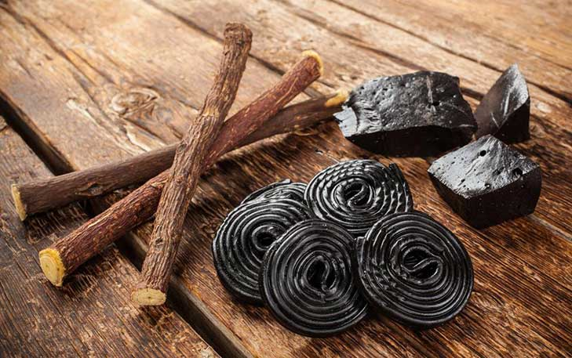
Deglycyrrhized Licorice DGL
Flavonoid-rich extract from Glycyrrhiza glabra
Beneficial in functional dyspepsia
Antioxidant, anti-inflammatory and anti- H.pylori
Compatible with:
Probiotics
Digestive enzymes
Reduces gastrointestinal inflammation

Slide 46
Collagen Helps:
Balance Stomach Acid
Hydrate the Digestive Tract (Hydrophilic)
Repair the Stomach and Intestines
vital to gene expression, enzyme activity, and regulation of cellular growth
Irritable Bowel Syndrome (IBS) and Stomach Ulcers
Repair Leaky Gut
Type I and Type III collagen are excellent sources for improving gut health.

Slide 47
Supplements: Betaine Hydrochloride
Corrects and prevents low stomach acid (Hypochlorhydria)
atrophic gastritis, excess intake of sugar and refined foods, nutritional deficiencies, and advancing age are causative factors
Hydrochloric acid normally secreted by gastric parietal cells
Bactericidal, it kills a large portion of bacteria ingested with the food and reduces bacteria entering the small intestine

Slide 48
Betaine Hydrochloride
Changes in gut microbiome & colonisation of the normally sterile small intestine d/t inadequate stomach acid→ risk factor for Small Intestinal Bacterial Overgrowth (SIBO)
Proton pump inhibitor (PPI) → SIBO in 50% of people on long-term treatment, which alters the microbiome
Protein has the greatest effect in promoting gastric acid secretion in dogs

Slide 49
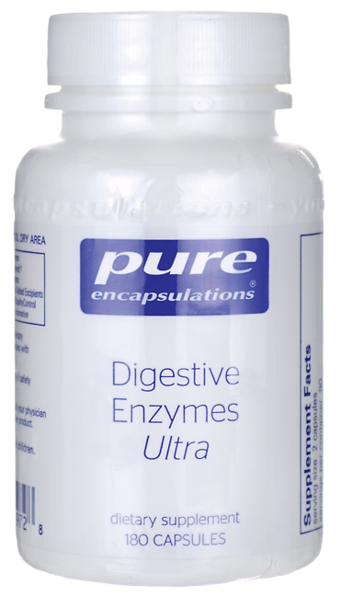
Digestive Enzymes
Enzymes between meals enter bloodstream and help digest food particles that may have slipped through due to leaky gut
We commonly use this in atopic dogs and allergic humans!

Slide 50
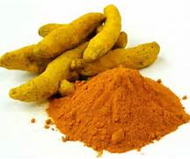
Curcumin- Turmeric
Curcuma longa
A spice and food-coloring agent
Exhibits multiple biological activities, despite poor bioavailability
Concentrates in the GIT after oral administration, which significantly improves microbiome
Reverses resistance of infectious bacteria to conventional antibiotics, and is antibacterial

Slide 51
Microbiome in Arthritis
RA patients have altered intestinal microbiota
Decreased Bifidobacterium, Lactobacillus and Bacteroides-Porphyromonas-Prevotella species
Increased opportunistic Enterobacteria and Staphylococci species
Variable reports of Clostridium profiles
In Osteoarthritis (OA) increased Clostridium & Staphylococcus
Pain relief meds such as acetaminophen and NSAIDs) contribute to altered bacterial profiles & gastrotoxic effects

Slide 52
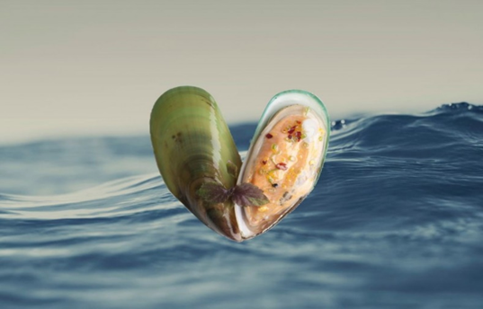
Perna Canaliculus
Influences bacterial viability, growth and metabolic activity
Fatty acids and protein with anti-inflammatory and immunomodulating activity
Interaction of bioactive compounds in Perna with commensal and pathogenic bacterial may →development of novel interventions to control intestinal and extra-intestinal inflammation

Slide 53
Perna, glucosamine, et.al.
Arthritis alleviation, may involve the actions of the gut microbiota to down-regulate gut mucosal inflammatory sequelae
May act as prebiotics in the gut, attenuating musculoskeletal inflammatory pain via interactions with the GIT microbiome →modification of inflammatory conditions such as OA, RA, asthma and IBD

Slide 54
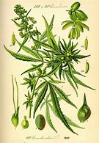
Endogenous Cannabinoid System
Cannabis sativa used to treat many GIT inflammatory disorders: vomiting, anorexia, diarrhea
Intestinal barrier function regulated via activation of the intestinal cannabinoid type 1 receptor (CB1R), which has protective role in colonic permeability

Slide 55
Cannabinoid System
The gut microbiota & nutrients regulate the intestinal barrier, via setting tone of GIT endocannabinoid system
The opposing effects of various cannabinoids on intestinal permeability
endocannabinoids such as anandamide worsen permeability
phytocannabinoids like tetrahydrocannabidiol & cannabidiol (partial CB1R antagonists) promote protection or recovery from intestinal permeability

Slide 56
FECAL MICROBIOTA TRANSPLANTS- FMT
AKA- microbiome restorative therapy or fecal bacteriotherapy
Italian anatomist, Girolamo Fabrizio,(1700’s) described a tranfer of chewed food from a healthy animal to a sick one in ruminants
Probiotic products might have a limited ability to alter composition of the GIT microbiome permanently d/t diversity

Slide 57
FMT Indications
When complex change is needed (e.g. C. difficile infection or IBD), often associated with antibiotic induced dysbiosis
Chronic gastrointestinal disorders, as well as autoimmune, cardio-metabolic and other extraintestinal conditions
Two reviews show safety and efficacy in 83–92% of human patients, who achieved full resolution of clinical signs

Slide 58
FMT Studies “The Blend”
FMT from lean to overweight individuals improved metabolic syndrome, e.g. increased insulin sensitivity

Slide 59
FMT Study in Dogs- 1
A canine case report in eosinophilic IBD of 2 years duration
FMT by enema
Fecal consistency improved within 24 hrs and the dog was clinically well 3 months post-treatment
Gene sequencing of the fecal microbiome: by day 2 after FMT, the dogs’ fecal sample clustered with the donor, not the own baseline sample
species richness increased

Slide 60
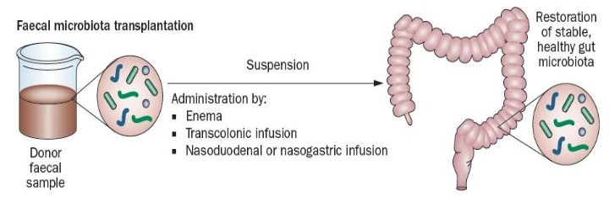
FMT Study in Dogs-2
FMT enema in 8 dogs with refractory presumptive C. perfringens-associated diarrhea
Immediate resolution of diarrhea
6/8 dogs were negative on follow-up PCR panels for C. perfringens alpha toxin

Slide 61
Summary
Imbalances in the composition of bacterial community in the intestine →transient intestinal dysfunctions, barrier modulation, and chronic disease states such as IBD, Crohns, skin, kidney, heart, mental diseases et.al.
Understanding how this ecosystem is regulated, e.g. by diet and other exogenous factors, and how to manipulate it is thus essential for disease prevention and therapy.

Slide 62
Stevie- IBD First Presentation- 10-9-09

Slide 63
GI of Unknown Origin
10/09/2009 Feline Stevie H.
Presented for ongoing anorexia, vomiting, lethargy, and weight loss
Intermittent pruritis
Started on Probiotic 123 and Arabinogalactan

Slide 64
Stevie- 2 weeks later
10-23 Presented for continuing GI issues- vomiting and anorexia
CBC- lymphopenia .65 (5-30)
platelets 527 (120-500)
Chem ALT 325 (20-100)
I would run a pancreatic lipase if seen today!

Slide 65
Stevie- Treatment
Injection of Hepeel comp + Chol heel
(we often use Hepar + Veratrum in these, too!)
Fluids Lactated Ringers sub-q
Reglan inj.
Sent home with Inflammation cocktail/Ranunculus/ Engystol
Lactulose

Slide 66
Stevie- continuing saga
We had many ups and downs over the next week or two with vomiting, constipation and weight loss d/t anorexia
C. 1 month after initial presentation, brought Stevie in for euthanasia
Barium study- no progress past small intestine
This cat did NOT want to die
Hospitalized

Slide 67
Stevie- Exploratory
On the basis of radiographs, assumed obstruction
Surgical exploratory revealed zilch
Primary r/o: Ileus
Post-surg- Zantac inj/ Fluids
Traumeel/Nux Vomica
Nasogastric tube placed
Fluids

Slide 68
Stevie- 2 weeks in hospital!
Ongoing fluids
Rectal feeding (vomited oral foods)
Cyproheptadine -(didn’t work….)
In desperation, I tried the new Thymus Extract we had just received, several days post surgery.
Stevie’s sense of well being skyrocketed and he started improving immediately.
Combine Hepar/Veratrum and Thymus Extracts

Slide 69
Stevie- Ongoing
Sent home 2 weeks post-surg
Eating, digesting food, active and alert
Sent home on Grumpy Gut (Nux Vomica/ Hepar/ Veratrum/ Podophyllum)
VetriScience Liver Chews
Have had another “episode” about 2 yrs after initial presentation
Still with us!

Slide 70
Stevie- One year later
Stevie was euthanized in 2019. At 17 years of age!!!

Slide 71
Jackson- GI Disease Jan. 2016
Diagnosed with coccidiosis as a puppy and treated, but Jackson continued to have loose stool with mucus.
4 yr old male German Shepherd
GI distress, vomiting, diarrhea w/ blood- persistent
Overgrowth of Clostridials on fecal cytology
CBC/Chem/cPl normal
TX: Cerenia, Penicillin inj., Famotidine, Amoxicillin, Canine I/D dog food
Diarrhea, persisted so Metronidazole was given→ short term improvement

Slide 72
Jackson Feb 2016 1 month
DX: bacterial colitis and SIBO
Feb.9, 2016Maldigestion Profile:
Clostridials persisted despite therapy and diet change

Slide 73
Jackson 2/23/16
Came to see us Prescribed Thymus Extract/ Nux Vomica/ Berberis/ Lymphomyosot/ Galium + Mucosa comp/ Mercurius Heel
Entero Health Pro
Nux Vomica/ Vomitusheel/ Anacardium/ Podophyllum tincture p.r.n.
Some immediate improvement in symptoms
Recommended “the blend” a fecal microbial transplant from the house mate, a shepherd with a cast iron gut

Slide 74
Significant Improvement w/ FMT

Slide 75
Jackson Referral to Okla.State
April 2016 (4 months)
Splenic enlargement prompted a referral to OSU
CBC, Chem, UA, were WNL
Splenic biopsy showed normal cells, so a breed specific splenic enlargement was diagnosed
Ehrlichia pos. But considered a non-active infection
NO significant findings on all testing
GI signs were improved. Therapy continued for several months.

Slide 76
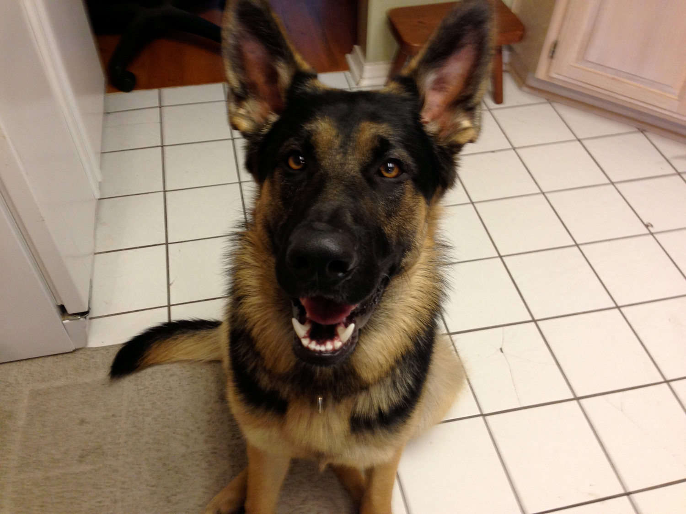

Slide 77
“Seed and Soil”
As we continue the study of microbiomics, I contend that we will find that many of our most successful therapies are due to alterations in the microbiota, thus restoring some balance to the body systems.
As Hippocrates once stated “All diseases begin in the gut.” It is well worth our effort to support the microbes that support us!

Slide 78
Questions?

